Slide 1
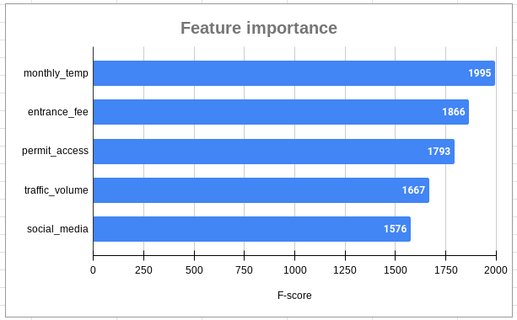
Visitation Prediction Project | ML Model Results
Executive summary prepared for NPS leadership by the NPS data team
NPS leadership asked the NPS data team to develop an ML model that will accurately predict future visitation at the most visited U.S. National Parks. A powerful model can help park managers better understand trends in future visitation, take proactive measures to protect the parks’ natural and cultural resources, and improve visitor experience.
Increased visitation is a major concern for the NPS because of the negative impact of overcrowding on the parks’ natural environments and wildlife, and on the overall quality of visitor experience. In 2022, the NPS received about 312 million recreation visits, an increase of 15 million visits from 2021. 26 percent of total visits occurred in the top 8 most visited parks.
To obtain a model with the highest predictive power, the NPS data team built two different models to cross-compare results: random forest and XGBoost. To develop the models, the data team analyzed historical data on recreation visits and other factors affecting visitation such as economic, weather, and transportation conditions.
The top 5 features related to visitation include monthly temperature, entrance fees, permit availability, traffic volume, and social media engagement.
The XGBoost model fits the data better than the random forest model. Further, the recall score is double the score of the previously built logistic regression model, while maintaining a similar accuracy and precision score.
The champion model achieved the accuracy goal set by the NPS leadership team, and is a viable model for forecasting visitation at the most visited national parks.
The data team recommends deploying the model at the top 8 most visited parks.
The data team will further refine the model based on data collected over the next year, with the ultimate goal of achieving highly accurate visitation forecasting for all 63 U.S. National Parks.

